Slide 1
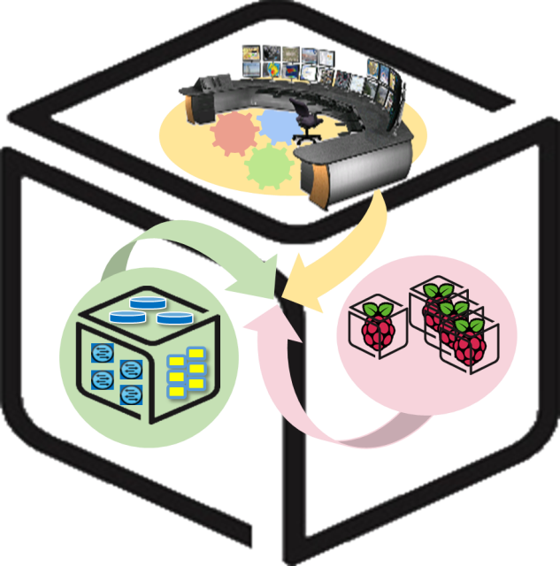
SmartX Labs for Computer Systems
Analytics Lab
(2016, Spring)
NetCS Lab

Slide 2
History and Contributor of Cluster Lab
(2016. 05. 02.)
Version | Updated Date | Updated Contents | Contributor
v2r2 | 2015/10 | (구) Analytics Lab 작성 | 송지원
v3 | 2016/05 | Analytics Lab 수정 | 송지원

Slide 3





CSLab: Analytics LAB
- Goal
Data Processing with Spark & Zeppelin
Data Processing & Visualization
Data

Slide 4
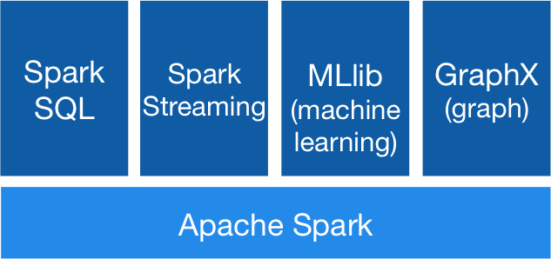
Apache Spark - Concept
Apache Spark™ is a fast and general engine for large-scale data processing.
In-memory data processing framework: Fast!
Easy to use, community fastly growing
Libraries: SQL and DataFrame, Streaming, MLlib, GraphX
Run on standalone or Mesos, Yarn, etc
Scala, Java, Python

Slide 5
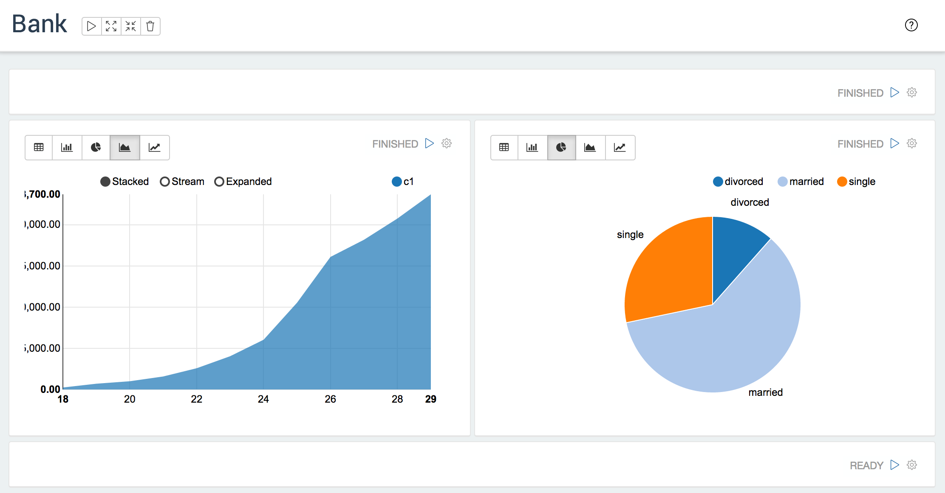
Apache Zeppelin
-Concept
A web-based notebook that enables interactive data analytics.
Support Spark

Slide 6

Tip. Pyspark: Spark in Python - Sample
# In zeppelin directory, make data directory and download sample data file.
$ cd zeppelin-0.5.5-incubating-bin-all
$ mkdir data
$ cd data
$ wget https://s3.amazonaws.com/apache-zeppelin/tutorial/bank/bank.csv
Zeppelin tutorial converted to pyspark
%pyspark
from pyspark.sql.types import *
zeppelinHome = os.getcwd()
bankText = sc.textFile(zeppelinHome + "/data/bank.csv")
bankSchema = StructType([StructField("age", IntegerType(), False),
StructField("job", StringType(), False),
StructField("marital", StringType(), False),
StructField("education", StringType(), False),
StructField("balance", IntegerType(), False)])
bank = bankText.map(lambda s: s.split(";")).filter(lambda s: s[0] != "\"age\"").map(lambda s: ( int(s[0]),
str(s[1]).replace("\"", ""),
str(s[2]).replace("\"", ""),
str(s[3]).replace("\"", ""),
int(s[5])))
bankdf = sqlContext.createDataFrame(bank, bankSchema)
bankdf.registerTempTable("bank")

Slide 7
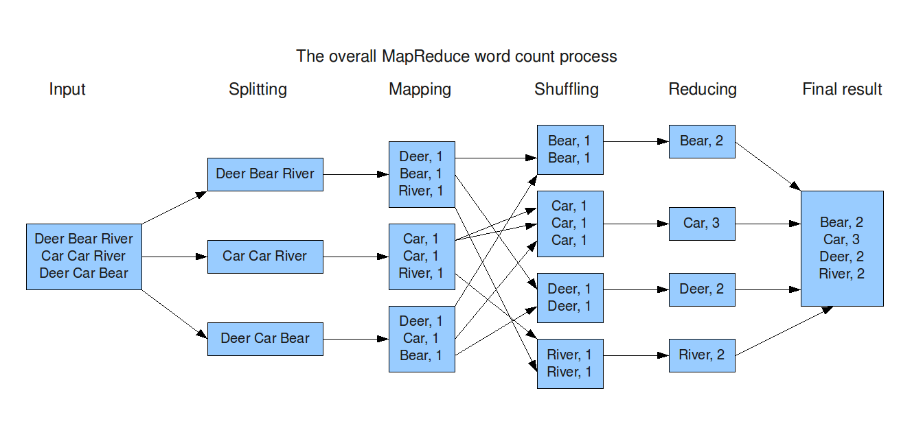
2. Processing Big Data - Map and Reduce

Slide 8
2. Processing Big Data - Map and Reduce in Spark
RDD (Resilient Distributed Datasets): a distributed memory abstraction that allows programmers to perform in-memory computations on large clusters while retaining the fault tolerance of data ﬂow models like MapReduce.
class pyspark.RDD
map()
groupBy(), groupByKey()
reduce(), reduceByKey()
join()
sort(), sortByKey()
union()
…
http://spark.apache.org/docs/latest/api/python/pyspark.html

Slide 9
3. Apache Zeppelin
- Wordcount
# Prepare data
cd zeppelin-0.5.5-incubating-bin-all
mkdir data
cd data
wget https://www.dropbox.com/s/dvtrxdr8am49yvv/wordcount.txt
Hadoop fs –put wordcount.txt /
# wordcount.txt: Remarks by President Obama at Hankuk University (https://www.whitehouse.gov/the-press-office/2012/03/26/remarks-president-obama-hankuk-university)

Slide 10
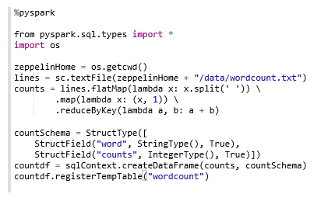
3. Apache Zeppelin - Wordcount
(If you have trouble using Zeppelin, restart Zeppelin daemon.)
$ bin/zeppelin-daemon.sh restart

Slide 11
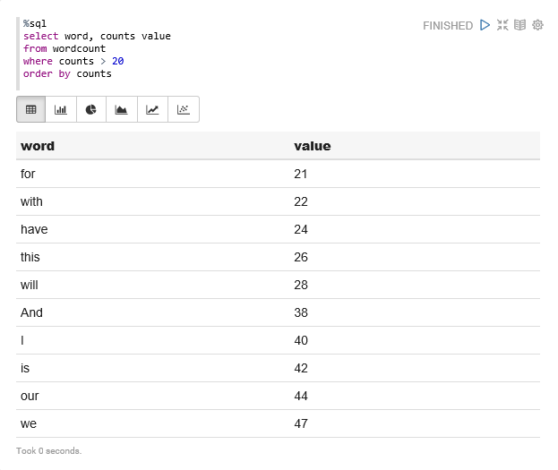
3. Apache Zeppelin - Wordcount (Result)

Slide 12
3. Apache Zeppelin - Data Cleaning
Actually, there are 26 ‘have’, 37 ‘this’ in wordcount.txt
We need to remove punctuation marks like ‘.’, ‘,’, etc.
It can be done by re.sub() and map() functions.
Add some codes to make dirty data clean and get the right answer.
This is to make complex model simple, or get better answer.

Slide 13
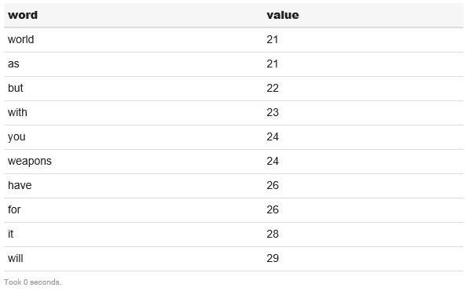
3. Apache Zeppelin - Wordcount (fixed)

Slide 14
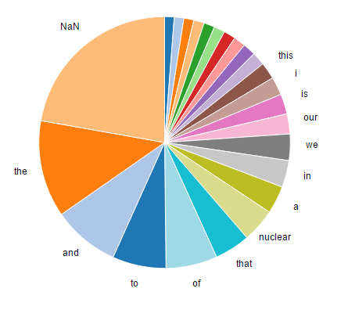
3. Apache Zeppelin - Wordcount - graph

Slide 15
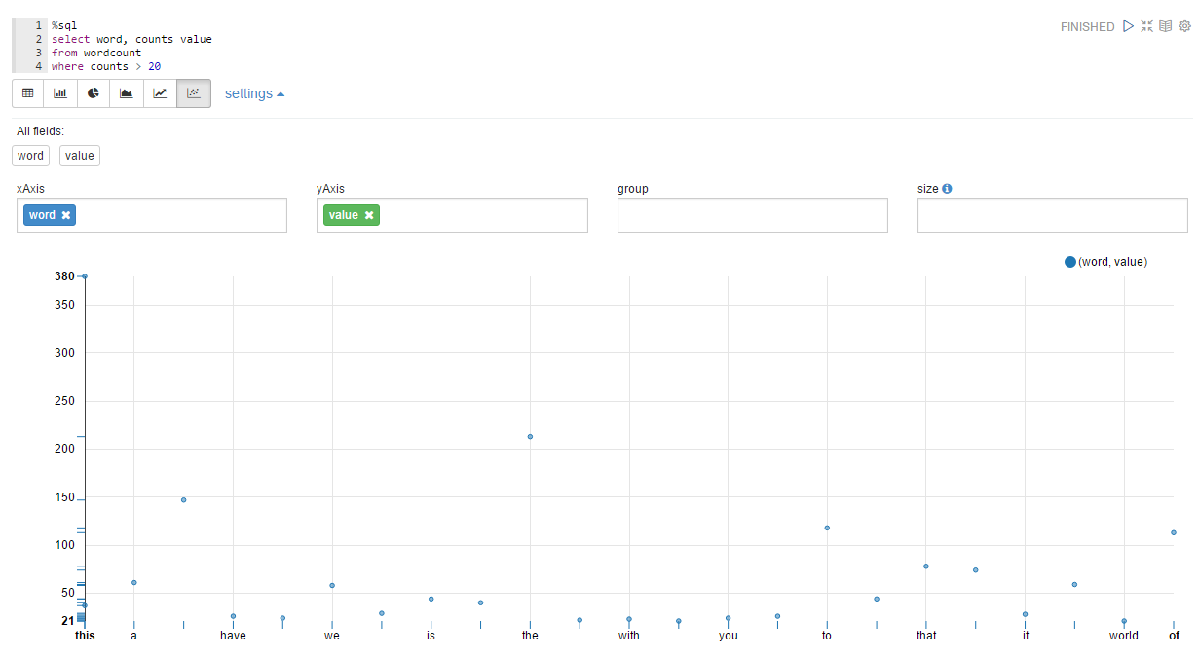
3. Apache Zeppelin - Wordcount - graph

Slide 16
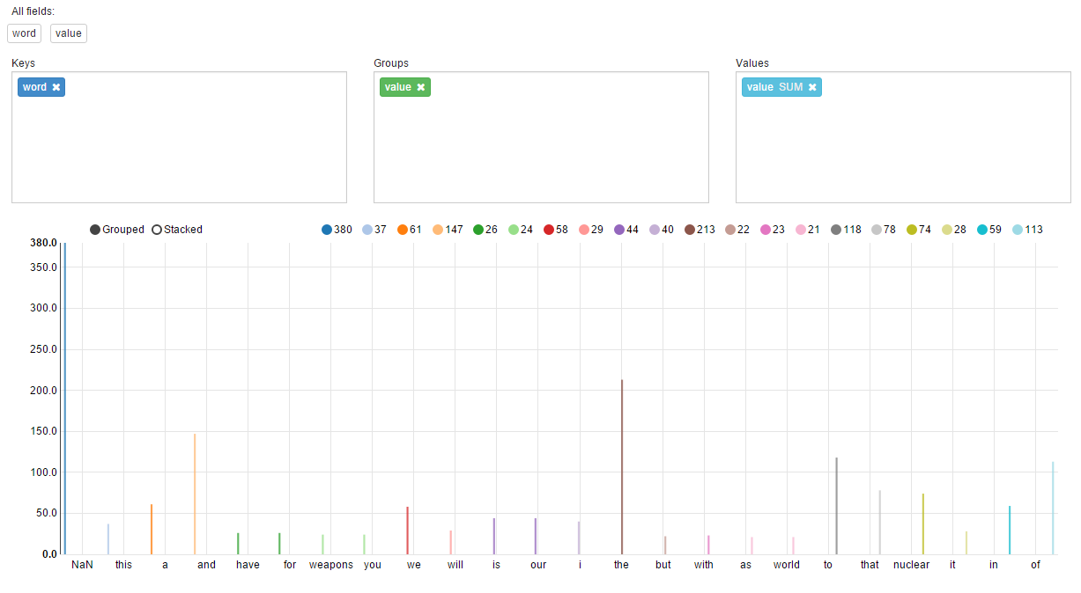
3. Apache Zeppelin - Wordcount - graph

Slide 17

Thank You for
Your Attention
Any Questions?

